Slide 1
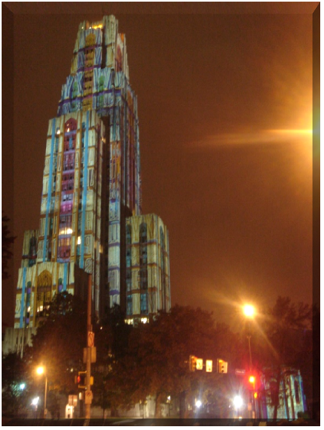
IS 2150 / TEL 2810
Introduction to Security
James Joshi
Associate Professor, SIS
Lecture 12.2
Nov 20, 2012
Integer Issues

Slide 2
Integer Security
Integers represent a growing and underestimated source of vulnerabilities in C and C++ programs.
Integer range checking has not been systematically applied in the development of most C and C++ software.
  security flaws involving integers exist
  a portion of these are likely to be vulnerabilities
A software vulnerability may result when a program evaluates an integer to an unexpected value.

Slide 3
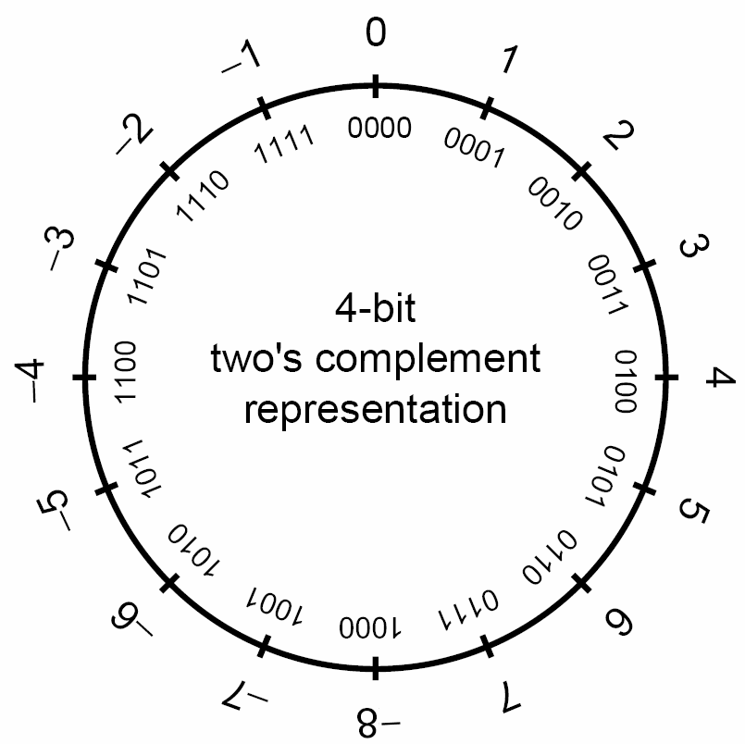
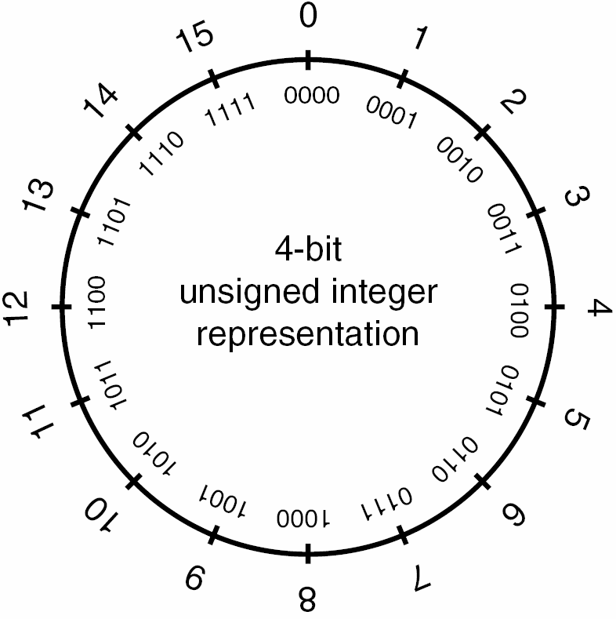
Representation
4-bit
two’s complement
representation
Signed Integer
Unsigned Integer

Slide 4
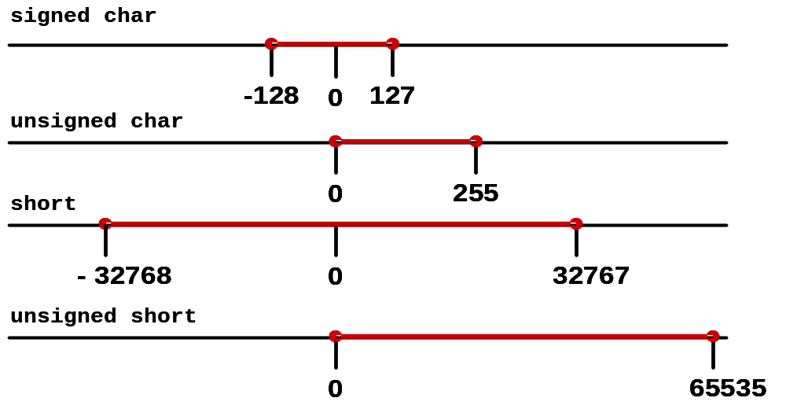
Example Integer Ranges

Slide 5
Integer Promotion Example
Integer promotions require the promotion of each variable (c1 and c2) to int size
      char c1, c2;
      c1 = c1 + c2;
    The two ints are added and the sum truncated to fit into the char type.
    Integer promotions avoid arithmetic errors from the overflow of intermediate values.

Slide 6
Implicit Conversions
The sum of c1 and c2 exceeds the maximum size of signed char
1. char cresult, c1, c2, c3;
2. c1 = 100;
3. c2 = 90;
4. c3 = -120;
5. cresult = c1 + c2 + c3;
However, c1, c1, and c3 are each converted to integers and the overall expression is successfully evaluated.
The sum is truncated and stored in cresult without a loss of data
The value of c1 is added to the value of c2.

Slide 7
From unsigned | To | Method
char | char | Preserve bit pattern; high-order bit becomes sign bit
char | short | Zero-extend
char | long | Zero-extend
char | unsigned short | Zero-extend
char | unsigned long | Zero-extend
short | char | Preserve low-order byte
short | short | Preserve bit pattern; high-order bit becomes sign bit
short | long | Zero-extend
short | unsigned char | Preserve low-order byte
long | char | Preserve low-order byte
long | short | Preserve low-order word
long | long | Preserve bit pattern; high-order bit becomes sign bit
long | unsigned char | Preserve low-order byte
long | unsigned short | Preserve low-order word
Key:
Lost data
Misinterpreted data

Slide 8
From | To | Method
char | short | Sign-extend
char | long | Sign-extend
char | unsigned char | Preserve pattern; high-order bit loses function as sign bit
char | unsigned short | Sign-extend to short; convert short to unsigned short
char | unsigned long | Sign-extend to long; convert long to unsigned long
short | char | Preserve low-order byte
short | long | Sign-extend
short | unsigned char | Preserve low-order byte
short | unsigned short | Preserve bit pattern; high-order bit loses function as sign bit
short | unsigned long | Sign-extend to long; convert long to unsigned long
long | char | Preserve low-order byte
long | short | Preserve low-order word
long | unsigned char | Preserve low-order byte
long | unsigned short | Preserve low-order word
long | unsigned long | Preserve pattern; high-order bit loses function as sign bit
Key:
Lost data
Misinterpreted data

Slide 9
Signed Integer Conversion Example
1. unsigned int l = ULONG_MAX;
2. char c = -1;
3. if (c == l) {
4. printf("-1 = 4,294,967,295?\n");
5. }
The value of c is compared to the value of l.
Because of integer promotions, c is converted to an unsigned integer with a value of 0xFFFFFFFF or 4,294,967,295

Slide 10
Overflow Examples 1
1. int i;
2. unsigned int j;
3. i = INT_MAX; // 2,147,483,647
4. i++;
5. printf("i = %d\n", i);
6. j = UINT_MAX; // 4,294,967,295;
7. j++;
8. printf("j = %u\n", j);
i=-2,147,483,648
j = 0

Slide 11
Overflow Examples 2
9. i = INT_MIN; // -2,147,483,648;
10. i--;
11. printf("i = %d\n", i);
12. j = 0;
13. j--;
14. printf("j = %u\n", j);
i=2,147,483,647
j = 4,294,967,295

Slide 12
Truncation Error Example
1. char cresult, c1, c2, c3;
2. c1 = 100;
3. c2 = 90;
4. cresult = c1 + c2;
Adding c1 and c2 exceeds the max size of signed char (+127)
Truncation occurs when the value is assigned to a type that is too small to represent the resulting value
Integers smaller than int are promoted to int or unsigned int before being operated on
Notes:
Integers smaller than int are promoted to int or unsigned int before being operated on.
Integers smaller than int are unlikely to overflow because the actual operations are performed on the promoted values.
These operations may result in a truncation error if the value is assigned to a variable of the size of the original operands.

Slide 13
Sign Error Example
1. int i = -3;
2. unsigned short u;
3. u = i;
4. printf("u = %hu\n", u);
Implicit conversion to smaller unsigned integer
There are sufficient bits to represent the value so no truncation occurs. The two’s complement representation is interpreted as a large signed value, however, so u = 65533

Slide 14
Integer Division
An integer overflow condition occurs when the minimum integer value for 32-bit or 64-bit integers are divided by -1.
  In the 32-bit case, –2,147,483,648/-1 should be equal to 2,147,483,648
  Because 2,147,483,648 cannot be represented as a signed 32-bit integer the resulting value is incorrect
- 2,147,483,648 /-1 = - 2,147,483,648
Notes:
Integer division overflows can be prevented by for 32-bit and 64-bit division by checking to see whether the numerator is the minimum value for the integer type and the denominator is -1.
Division by zero can be prevented by ensuring that the divisor is non-zero.

Slide 15
Vulnerabilities Section Agenda
Integer overflow
Sign error
Truncation
Non-exceptional
Integer overflow
Sign error
Truncation
Non-exceptional

Slide 16
JPEG Example
Based on a real-world vulnerability in the handling of the comment field in JPEG files
Comment field includes a two-byte length field indicating the length of the comment, including the two-byte length field.
To determine the length of the comment string (for memory allocation), the function reads the value in the length field and subtracts two.
The function then allocates the length of the comment plus one byte for the terminating null byte.

Slide 17
Integer Overflow Example
1. void getComment(unsigned int len, char *src) {
2. unsigned int size;
3. size = len - 2;
4. char *comment = (char *)malloc(size + 1);
5. memcpy(comment, src, size);
6. return;
7. }
8. int _tmain(int argc, _TCHAR* argv[]) {
9. getComment(1, "Comment ");
10. return 0;
11. }
0 byte malloc() succeeds
Size is interpreted as a large positive value of 0xffffffff
Possible to cause an overflow by creating
an image with a comment length field of 1

Slide 18
Sign Error Example 1
Program accepts two arguments (the length of data to copy and the actual data)
1. #define BUFF_SIZE 10
2. int main(int argc, char* argv[]){
3. int len;
4. char buf[BUFF_SIZE];
5. len = atoi(argv[1]);
6. if (len < BUFF_SIZE){
7. memcpy(buf, argv[2], len);
8. }
9. }
len declared as a signed integer
argv[1] can be a negative value
A negative value bypasses the check
Value is interpreted as an unsigned value of type size_t

Slide 19
Sign Errors Example 2
The negative length is interpreted as a large, positive integer with the resulting buffer overflow
This vulnerability can be prevented by restricting the integer len to a valid value
  more effective range check that guarantees len is greater than 0 but less than BUFF_SIZE
  declare as an unsigned integer
    eliminates the conversion from a signed to unsigned type in the call to memcpy()
    prevents the sign error from occurring

Slide 20
Truncation:
Vulnerable Implementation
1. bool func(char *name, long cbBuf) {
2. unsigned short bufSize = cbBuf;
3. char *buf = (char *)malloc(bufSize);
4. if (buf) {
5. memcpy(buf, name, cbBuf);
6. if (buf) free(buf);
7. return true;
8. }
9. return false;
10. }
cbBuf is used to initialize bufSize which is used to allocate memory for buf
cbBuf is declared as a long and used as the size in the memcpy() operation

Slide 21
Vulnerability 1
cbBuf is temporarily stored in the unsigned short bufSize.
The maximum size of an unsigned short for both GCC and the Visual C++ compiler on IA-32 is 65,535.
The maximum value for a signed long on the same platform is 2,147,483,647.
A truncation error will occur on line 2 for any values of cbBuf between 65,535 and 2,147,483,647.

Slide 22
Vulnerability 2
This would only be an error and not a vulnerability if bufSize were used for both the calls to malloc() and memcpy()
Because bufSize is used to allocate the size of the buffer and cbBuf is used as the size on the call to memcpy() it is possible to overflow buf by anywhere from 1 to 2,147,418,112 (2,147,483,647 - 65,535) bytes.

Slide 23
Mitigation
Type range checking
Strong typing
Compiler checks
Safe integer operations
Testing and reviews

Slide 24
Type Range Checking Example
1. #define BUFF_SIZE 10
2. int main(int argc, char* argv[]){
3. unsigned int len;
4. char buf[BUFF_SIZE];
5. len = atoi(argv[1]);
6. if ((0<len) && (len<BUFF_SIZE) ){
7. memcpy(buf, argv[2], len);
8. }
9. else
10. printf("Too much data\n");
11. }
.
Implicit type check from the declaration as an unsigned integer
Explicit check for both upper and lower bounds

Slide 25
Strong Typing
One way to provide better type checking is to provide better types.
Using an unsigned type can guarantee that a variable does not contain a negative value.
This solution does not prevent overflow.
Strong typing should be used so that the compiler can be more effective in identifying range problems.

Slide 26
Strong Typing Example
Declare an integer to store the temperature of water using the Fahrenheit scale
  unsigned char waterTemperature;
waterTemperature is an unsigned 8-bit value in the range 1-255
unsigned char
  sufficient to represent liquid water temperatures which range from 32 degrees Fahrenheit (freezing) to 212 degrees Fahrenheit (the boiling point).
  does not prevent overflow
  allows invalid values (e.g., 1-31 and 213-255).

Slide 27
Source Code Audit
Source code should be audited or inspected for possible integer range errors
When auditing, check for the following:
  Integer type ranges are properly checked.
  Input values are restricted to a valid range based on their intended use.
Integers that do not require negative values are declared as unsigned and properly range-checked for upper and lower bounds.
Operations on integers originating from untrusted sources are performed using a safe integer library.

Slide 28
Notable Vulnerabilities
Integer Overflow In XDR Library
  SunRPC xdr_array buffer overflow
  http://www.iss.net/security_center/static/9170.php
Windows DirectX MIDI Library
  eEye Digital Security advisory AD20030723
  http://www.eeye.com/html/Research/Advisories/AD20030723.html
Bash
  CERT Advisory CA-1996-22
  http://www.cert.org/advisories/CA-1996-22.html

